Slide 1
(Programmatic) Access to Data Distributed by IOOS
OceanHackWeek, Seattle, WA
August 21, 2018
Emilio Mayorga, NANOOS & University of Washington
mayorga@apl.washington.edu
https://github.com/emiliom
(From materials by:
Micah Wengren,
Richard P. Signell
Luke Campbell)

Slide 2
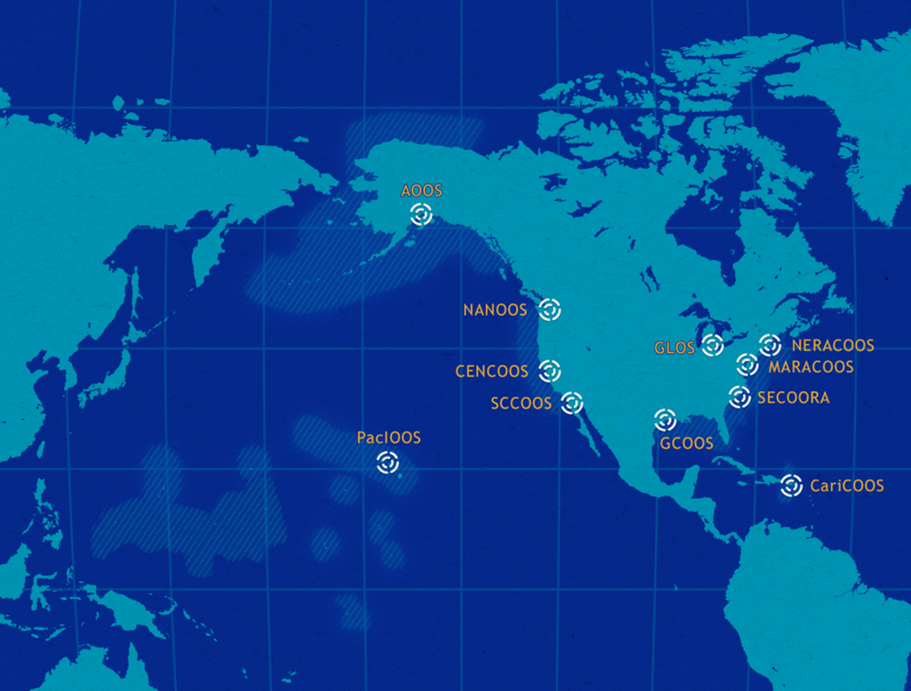
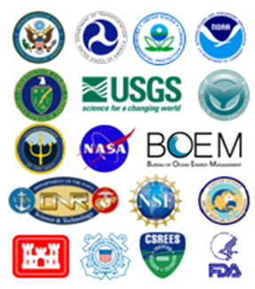
IOOS DMAC Standards
U.S. Integrated Ocean Observing System (IOOS) works with 11 Regional Associations and 17 Federal agencies to build this observing (and modeling) network and distribute information
This is the theme text
Federal Partners

Slide 3
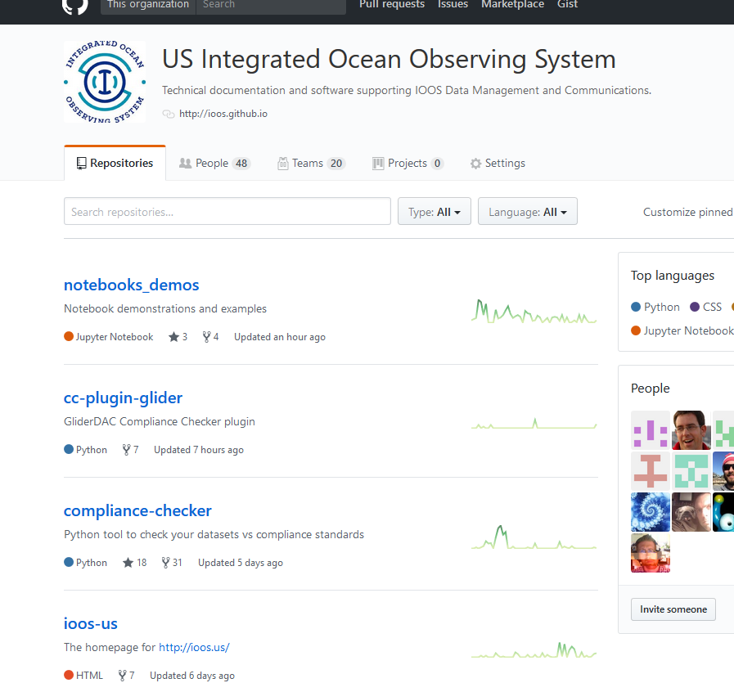
What is DMAC?
DMAC is the collection of people, process, and technology that enable the dissemination of diverse and distributed data sets using the WWW as the platform.
See https://ioos.us and https://ioos.noaa.gov/project/dmac/
DMAC = Data Management and Communications
IOOS GitHub OS Projects:
pyoos
compliance-checker
notebooks_demos
ncSOS
sensorml2iso
catalog-harvest-registry
i52N-sos
And more: https://github.com/ioos/

Slide 4
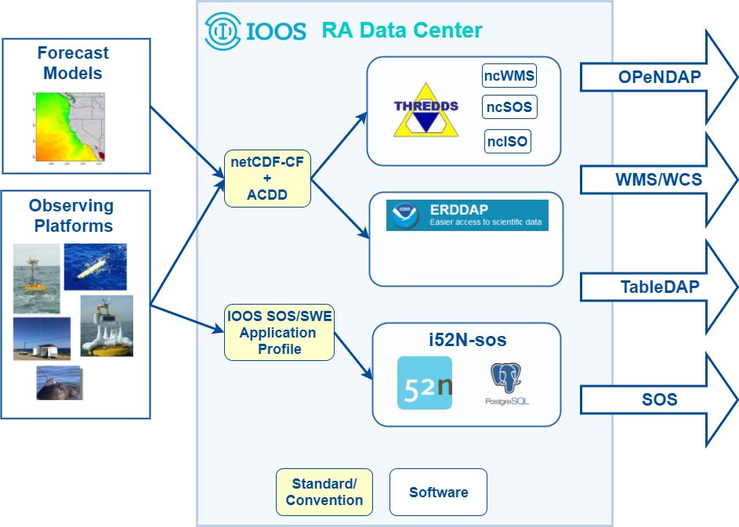
IOOS DMAC Data Distribution
A distributed system

Slide 5
DMAC Software
THREDDS:
Climate & Forecast Conventions (CF) and ACDD- compatible netCDF files
CF Discrete Sampling Geometry for observations
UGRID (unstructured grid) conventions for forecast model output
THREDDS Services/Extensions used by IOOS DMAC:
ncWMS: extends WMS with custom extensions for scientific data
GeoServer 2.10+ community module: http://bit.ly/2usZrqM implements exts:
GetMap enhancements: dynamic color ramps from data statistics and extra parameters, GetTimeSeries operation, GetCaps filtering
ncISO: output ISO 19115-2 XML metadata from CF attribution
ncSOS: provide IOOS profile compatible SOS service from CF Discrete Sampling Geometry input files - http://bit.ly/2vqvox9
ERDDAP:
GridDAP(gridded data), TableDAP (tabular data) - http://bit.ly/2vT3o8o
RESTful service interface providing translation between many input/output data formats, databases, or data stores
i52N-SOS:
Fork of 52North SOS server meeting IOOS SOS profile requirements

Slide 6
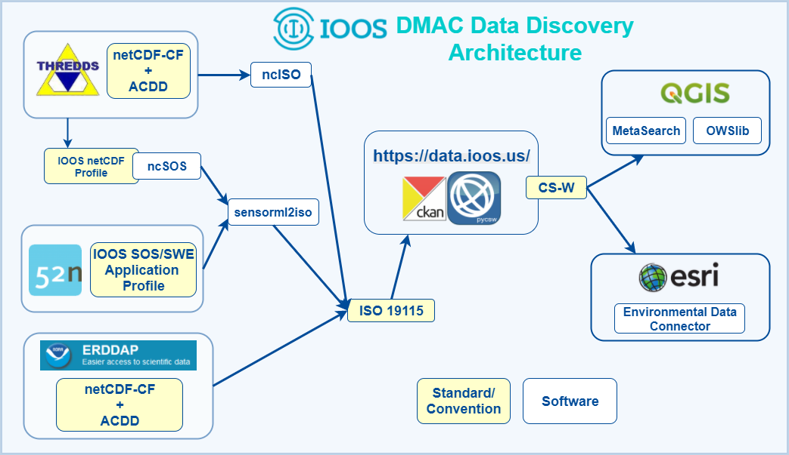
IOOS DMAC Data Discovery
Metadata and service endpoint integration and discovery
Python CSW Client in Jupyter

Slide 7
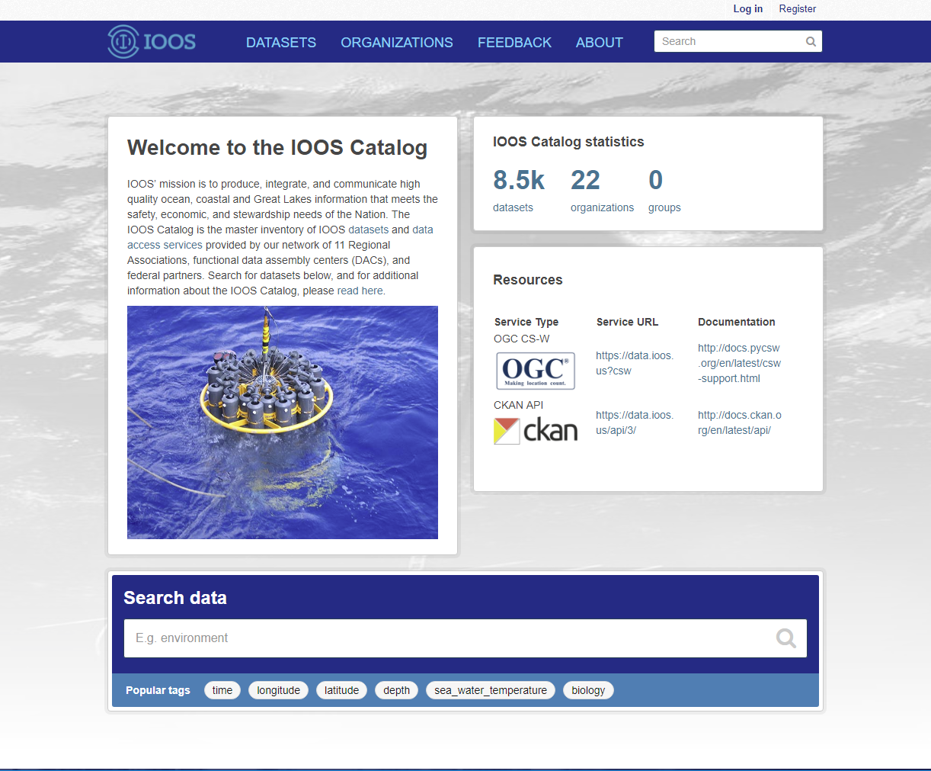
IOOS Catalog and Dataset Discovery
https://data.ioos.us
IOOS Catalog is an inventory of IOOS’ data access services and the glue between RA infrastructure and IOOS’ national products.
IOOS Catalog is also a tool for end users to discover IOOS data products for their geographic region of interest.

Slide 8
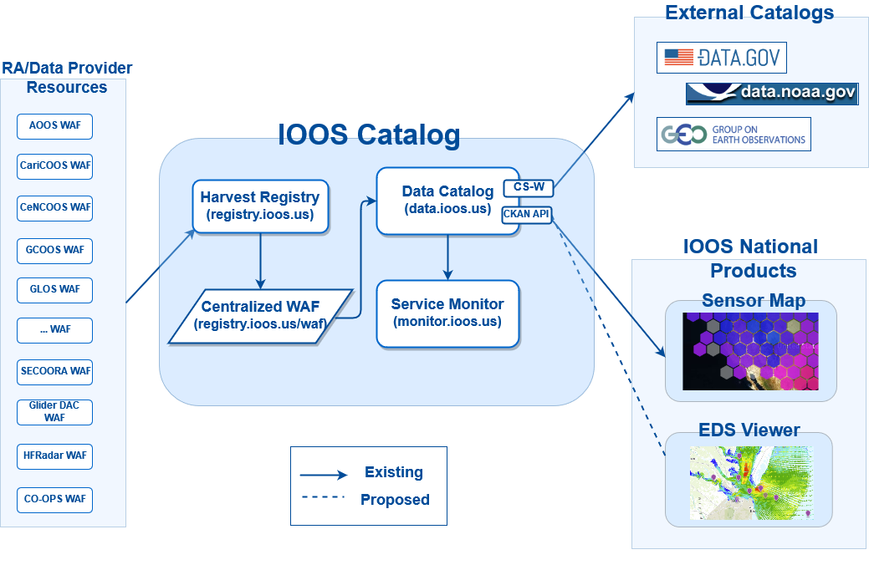
IOOS Catalog
Functional / thematic DACs (also waves, ...)

Slide 9
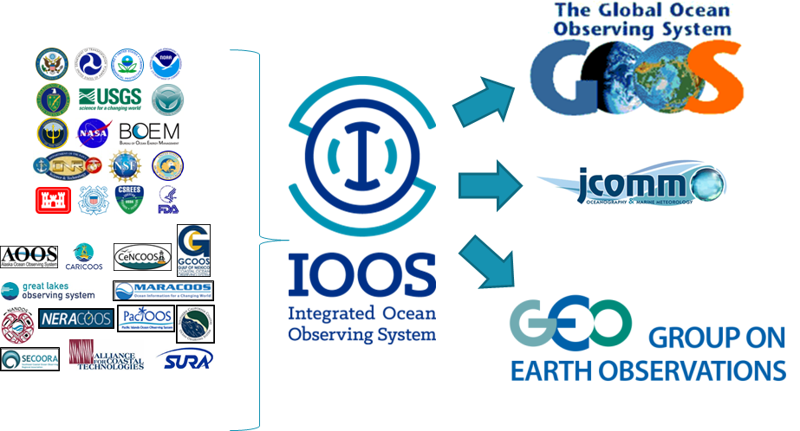
Data Integration: Regional to National to Global

Slide 10
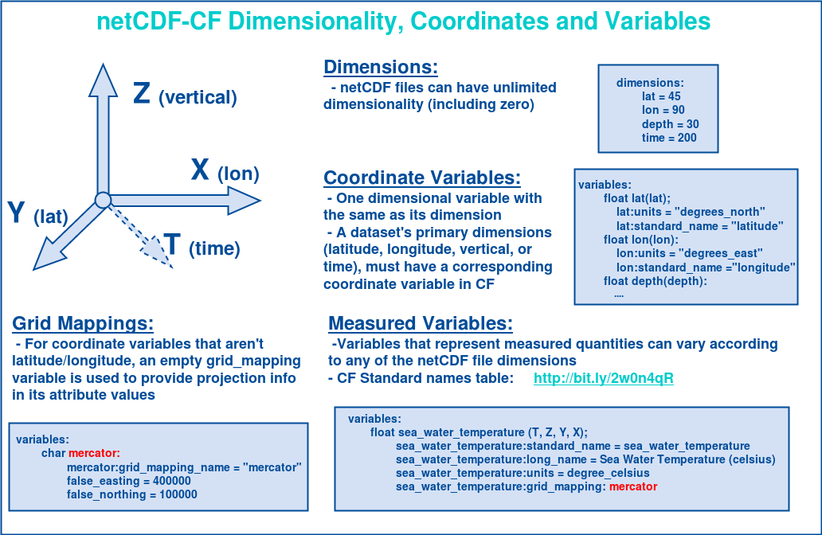
netCDF Climate and Forecast (CF) Conventions

Slide 11
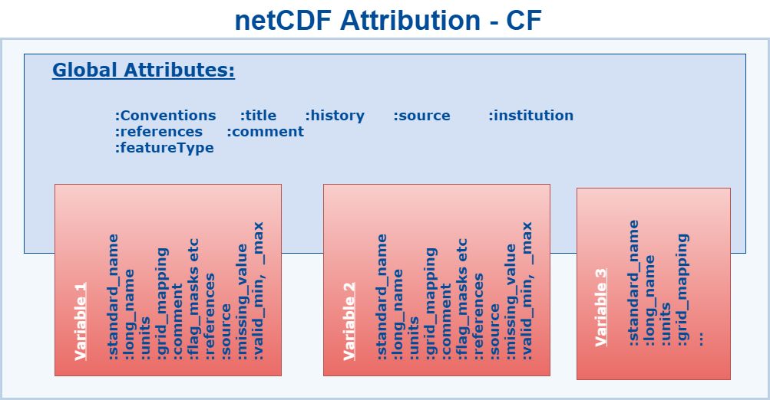
CF Conventions: http://cfconventions.org/cf-conventions/v1.6.0/cf-conventions.html

Slide 12
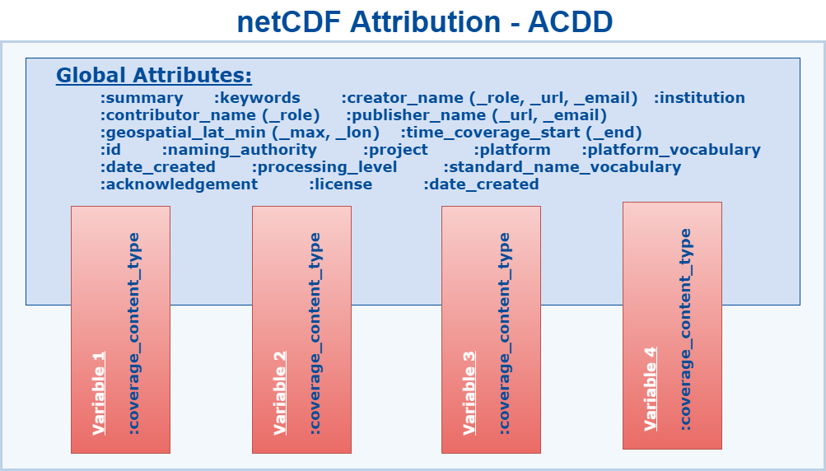
ACDD Documentation: http://wiki.esipfed.org/index.php/Attribute_Convention_for_Data_Discovery

Slide 13
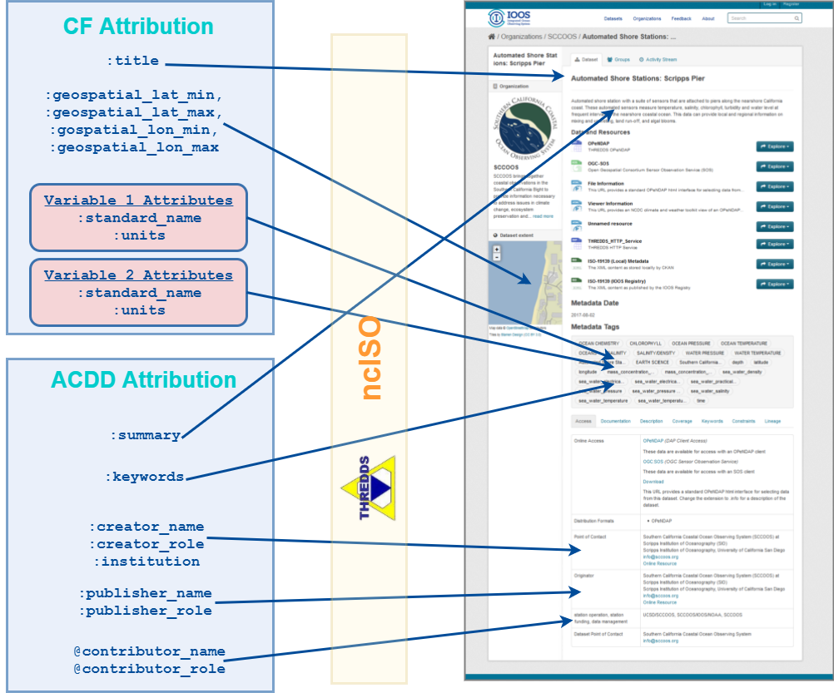
Metadata Conventions and Catalogs

Slide 14
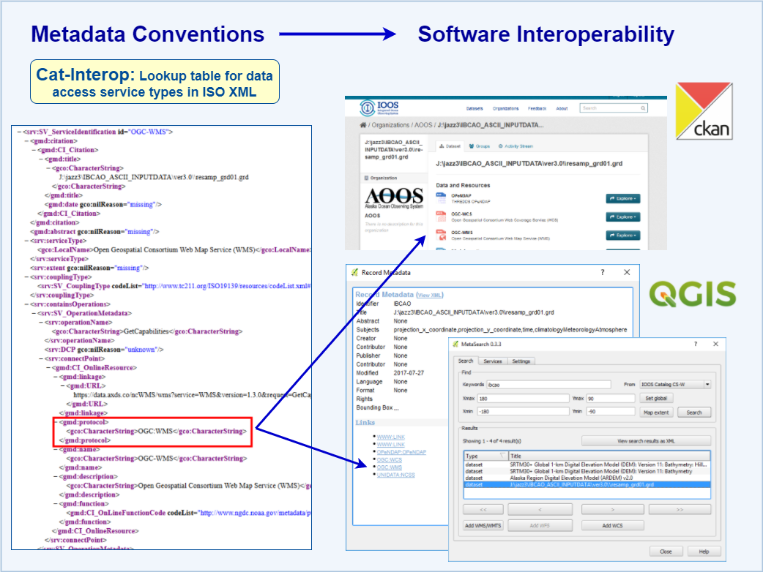
Cat-Interop for Service Interoperability

Slide 15
Existing IOOS Dataset Guidelines
IOOS DMAC Documentation Portal:
https://ioos.github.io/
IOOS netCDF Profile:
https://ioos.github.io/ioos-netcdf/ioos-netcdf-metadata-description-v1-1.html
Based on NCEI netCDF 2.0 templates, with some IOOS additions to handle IOOS asset identifier convention, SOS/SensorML interoperability (via ncSOS), and improved provider attribution in metadata
IOOS Asset Identifier Convention:
https://ioos.github.io/conventions-for-observing-asset-identifiers/ioos-assets-v1-0.html
IOOS Vocabulary Conventions:
Standardizing terminology: https://mmisw.org/ont/#/org/ioos

Slide 16
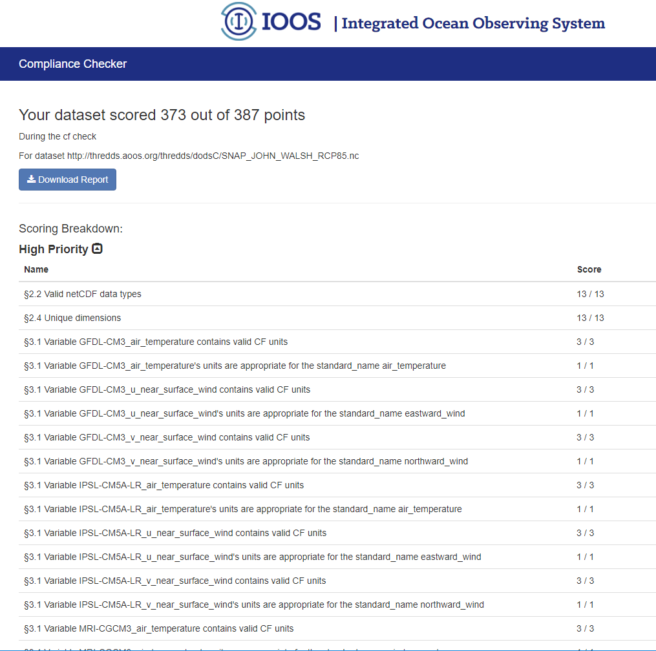
Compliance Checker
Compliance Checker
Compliance Checker is an open source tool developed and funded by IOOS that allows RAs, DACs, or other data publishers to test their netCDF file (and other encodings) compliance with DMAC standards
CC is a Python module and can either be installed locally for routine workflows or automation, and is also available online ->
CC and other IOOS DMAC software available on IOOS’ GitHub:
https://github.com/ioos/compliance-checker/
https://github.com/ioos/

Slide 17
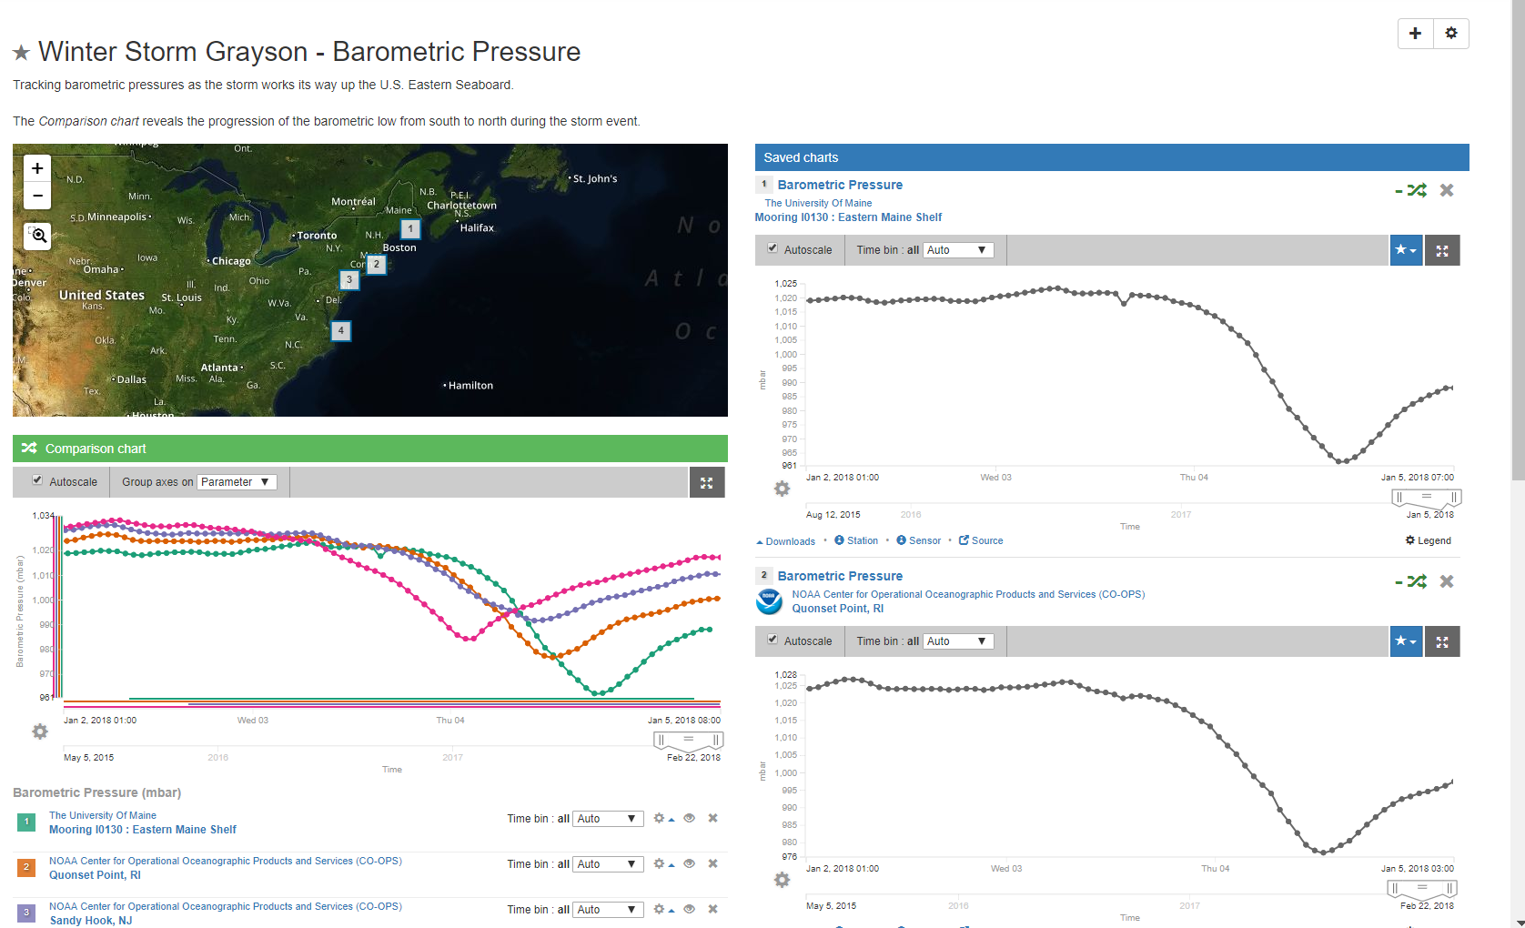
IOOS Sensor Map: Data Views

Slide 18
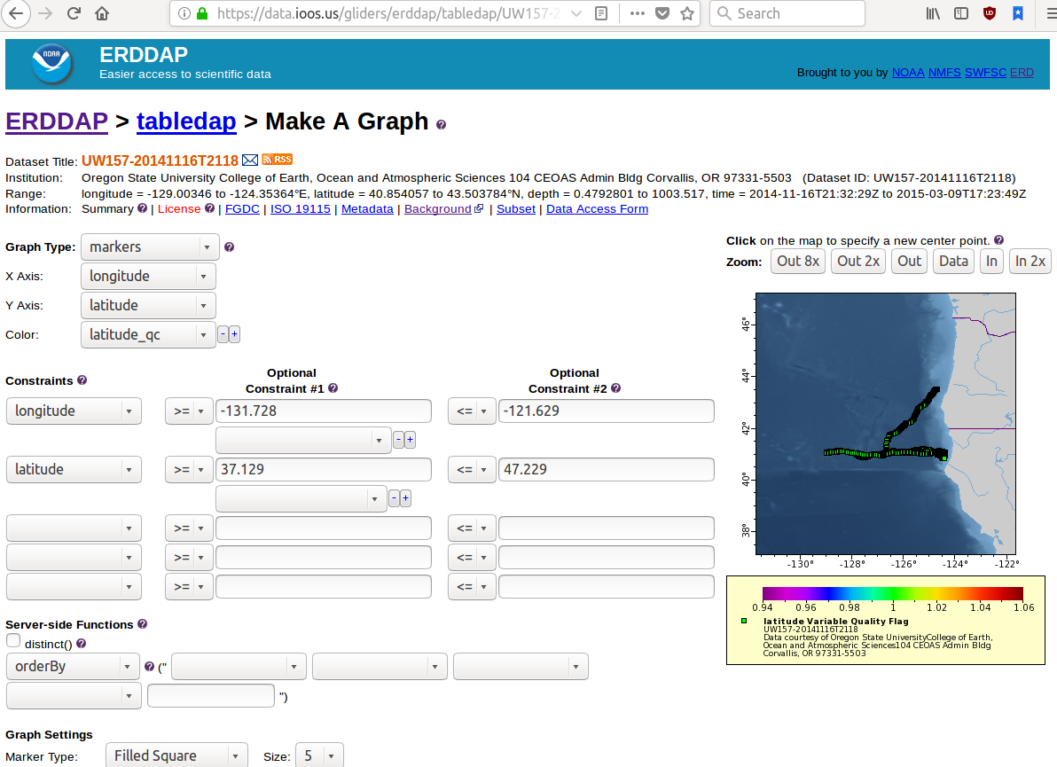
Extra Slides
Glider DAC ERDDAP
https://data.ioos.us/gliders/erddap/

Slide 19
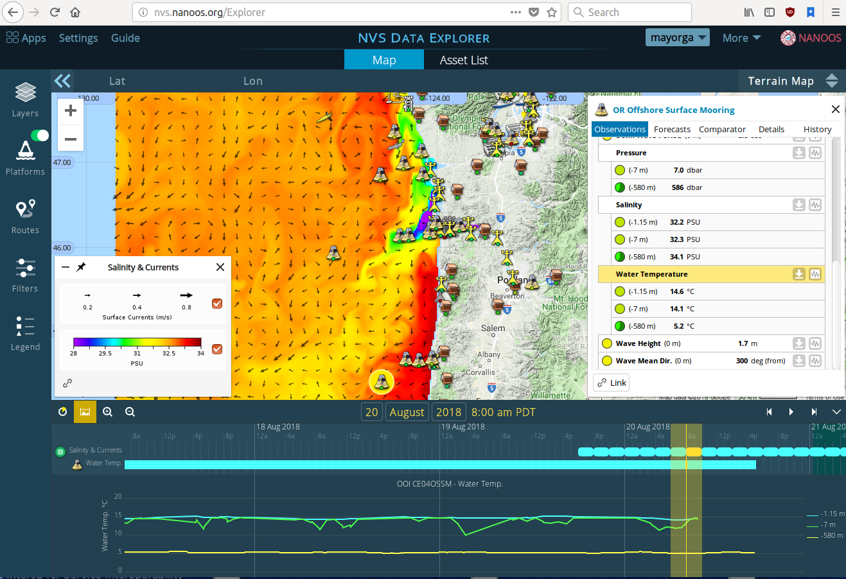
RA Application: NANOOS Visualization System (NVS)

Slide 20
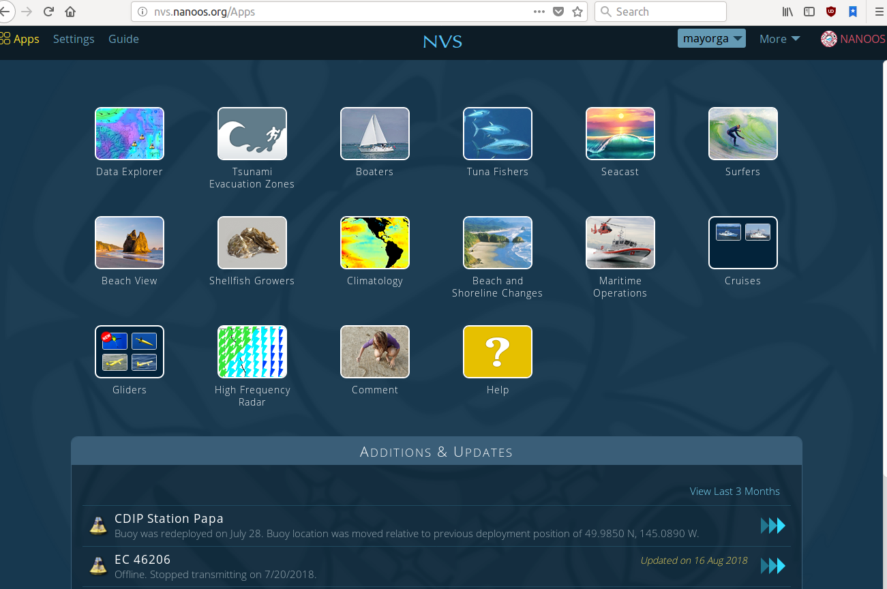
RA Application: NANOOS Visualization System (NVS)

Slide 21
Bonus Links
IOOS Data Demo Center: http://ioos.github.io/notebooks_demos/code_gallery/
IOOS Data Catalog: https://data.ioos.us/
THREDDS: http://www.unidata.ucar.edu/software/thredds/current/tds/
ncISO/threddsIso: https://github.com/Unidata/threddsIso
ncSOS: https://github.com/asascience-open/ncSOS
ncWMS: https://github.com/Reading-eScience-Centre/ncwms
ERDDAP: http://coastwatch.pfeg.noaa.gov/erddap/download/setup.html
i52N-SOS: https://github.com/ioos/i52n-sos

Slide 22
Demos
Python Jupyter Notebooks at
https://github.com/oceanhackweek/ohw2018_tutorials/tree/master/day2/ioos_data_access
(view at nbviewer)
01-iooscatalog_fixedlocationobs.ipynb: IOOS Catalog discovery (OGC CSW) and access for fixed-location observing assets in Endurance Array region
02-iooscatalog_models.ipynb: IOOS Catalog discovery (OGC CSW) and access for forecast models in Pioneer Array region
03-gliderdac_erddapy.ipynb: IOOS Glider DAC ERDDAP discovery and access for glider data in Endurance Array region

